Slide 1
Automating Cloud Deployment with Serverless & Terraform
Casper Kristiansson (casperkr@kth.se)
Nicole Wijkman (nwijkman@kth.se)

Slide 2
Project Overview
Goal
Automate the deployment of the backend of a web application to AWS.
Technologies Used
Terraform: Infrastructure as code to provision AWS services like DynamoDB.
Serverless Framework: Simplifies deployment of Lambda functions and API Gateway for AWS.
Key Components
DynamoDB: For data storage.
API Gateway & Lambda: For backend logic such as API endpoints.

Slide 3
What is Terraform & Serverless?
Terraform: Manages infrastructure as code for consistent, automated deployments.
Serverless: Automates code execution without managing servers, focusing on function scalability.

Slide 4
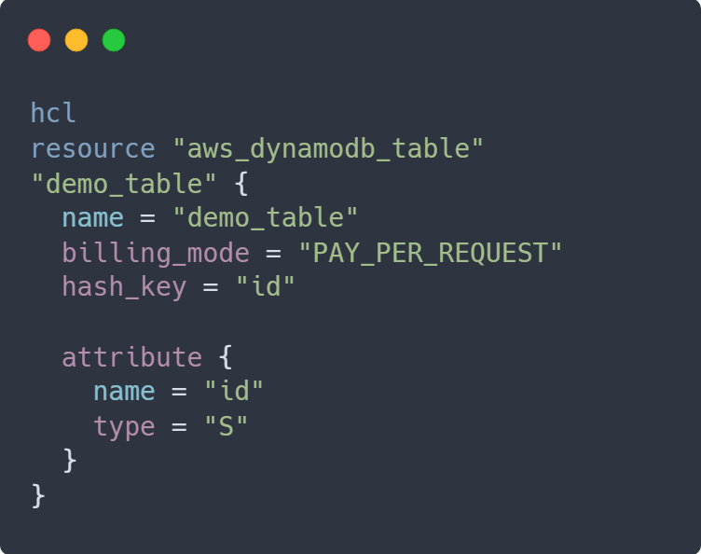
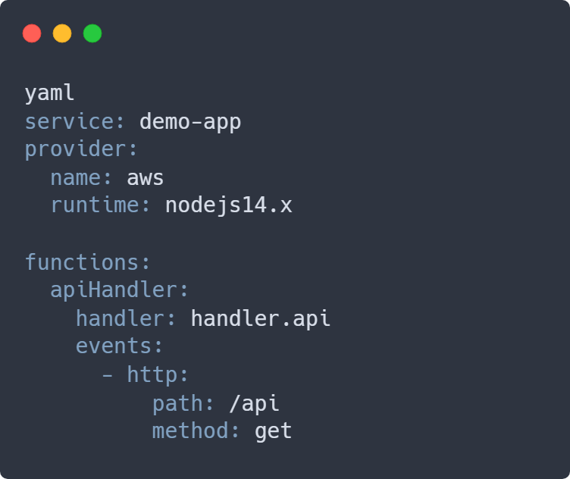
Code Examples: Terraform & Serverless
Terraform (DynamoDB Table)
Serverless (API Endpoint & Lambda)

Slide 5
Demo Plan
Step 1
Showcase the basic configurations of Serverless and Terraform
Step 2
Test the API endpoint with the initial configurations
Step 3
Destroy a database and remove a endpoint
Step 4
Test the API endpoint with the new configurations
Notes:
20-25s

Slide 6
Why Terraform?
What is Terraform?
Declarative Infrastructure-as-code tool.
Automates Cloud resource creation and managing.
Role in the Project
Provisioning DynamoDB table.

Slide 7
Why Serverless?
What is Serverless Framework?
Simplifies Serverless code and API Gateway deployment.
Scales without managing servers.
Role in the Project
Deploys and manages Lambda functions.
Connects API Gateway to Lambda functions.

Slide 8
Conclusion & Q&A
Key Takeaways
Automation using Terraform and Serverless simplifies Cloud infrastructure management.
Serverless is ideal for quickly deploying APIs, while Terraform is powerful for managing Cloud resources like DynamoDB.
Questions?

